Slide 1
Presentation on IOT based smart dustbin
Target audience:
Project supervisor, head of department(HOD), chief-student welfare council(swc)

Slide 2
Smart Dustbin With IOT Notifications
Every person in this world throws waste in the form of plastics, wet waste, dry waste and etc. Also, every person looks for a place or a plastic container to dispose that waste, that plastic container is the Dustbin which they look for. Dustbin is a plastic container where everyone can dispose their waste. Dustbin is used as a storage place to dispose waste, but we cannot estimate the exact amount of waste disposed by a society, and the dustbin cannot take more waste as the space should be available in it to take more. We need to know the level of waste in the dustbin and based on that we can intimate people to use the dustbin or not. In this Smart Dustbin project, we have designed a prototype where the lid of the dustbin is opened, on detection of human hand and waste, and the level of waste available inside the dustbin is sent as notification in the form of LED. The main components we used in making this prototype are Arduino, NODEMCU, Servo Motor and Ultrasonic Sensors. The software component is the application named as Blynk which is used to get notification. This dustbin can be a start to Smart Waste Management System where the officials can clean or empty the dustbin which depends on the notification received by them and not waiting for a call from a person of a society who informs the garbage trucks to come and take the waste from them.

Slide 3
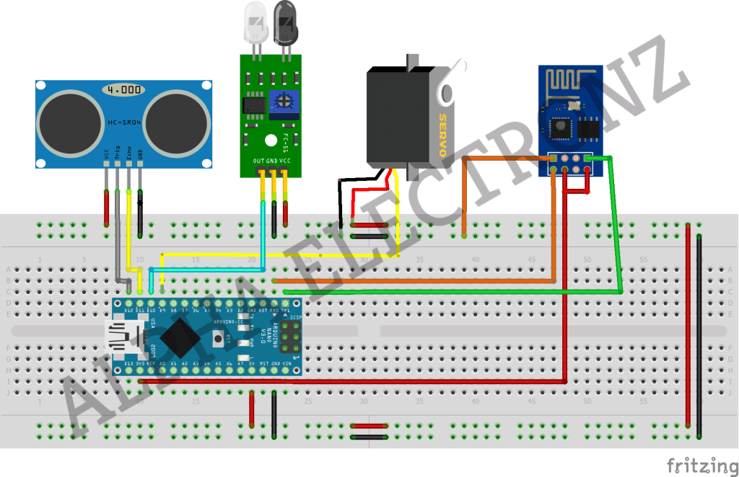
Circuit Diagram:

Slide 4
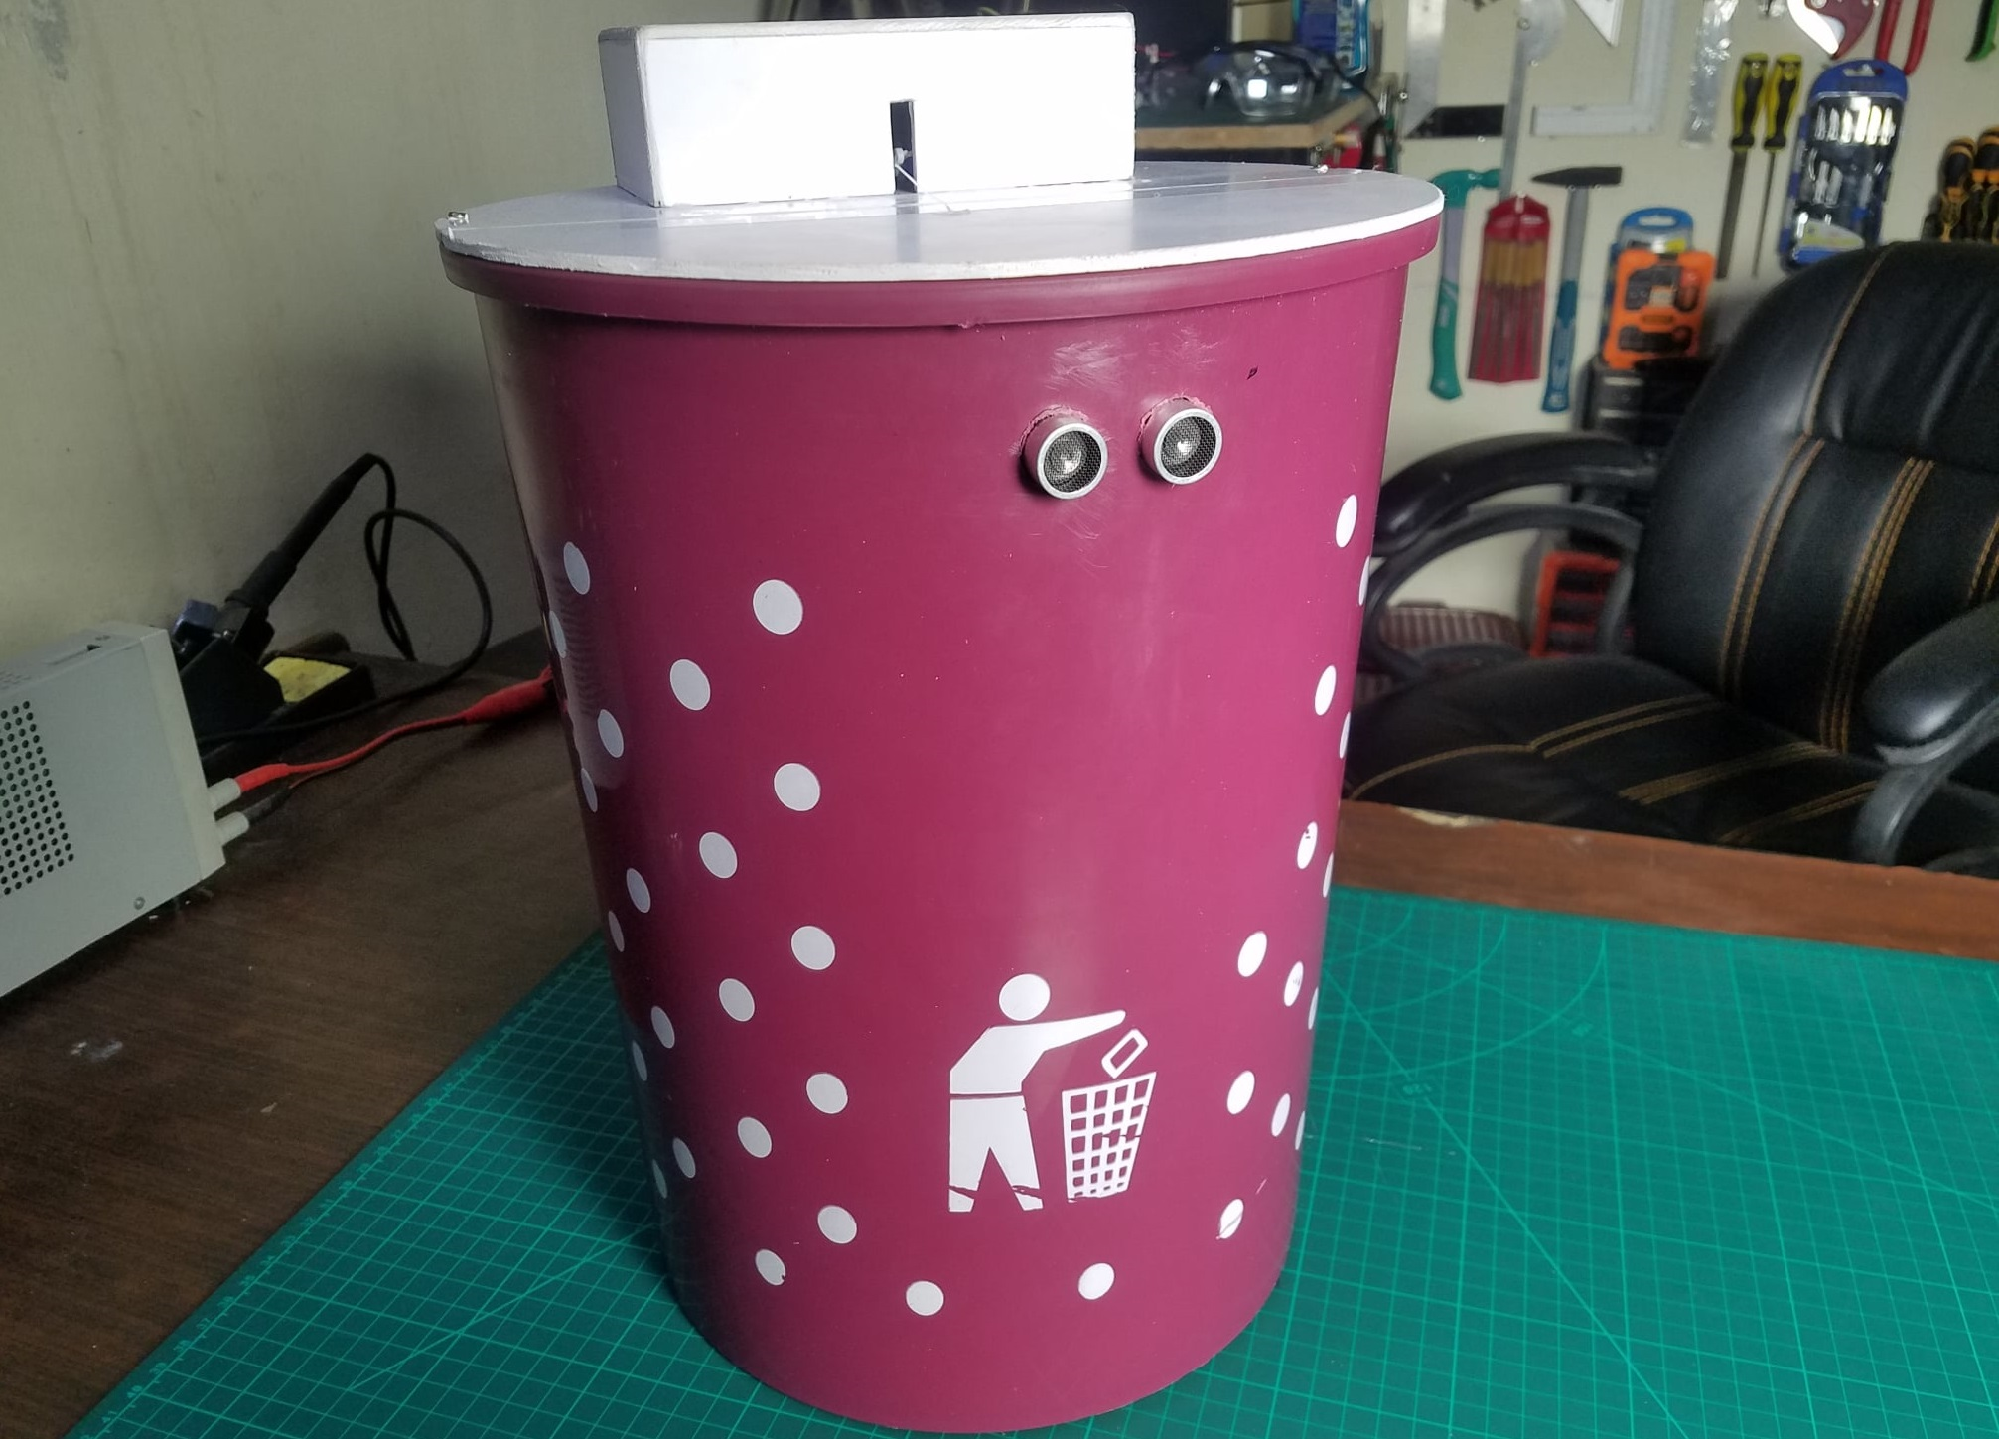
Proposed Model

Slide 5
Literature review
A Smart Dustbin proposed by , based on IoT in which the smart bin was built on a platform which was based on Aurdino Uno board which was interfaced with a GSM modem and an ultrasonic sensor. The sensor was placed on the top of the bin. A threshold level was set as 10cm. As the garbage reaches the level of threshold, the sensor triggers the GSM modem which alerts the associated authority till the garbage in the bin is emptied. At the end a conclusion was made that various issues like affordability, maintenance and durability were addressed when these smart bins were designed. It also contributed towards a hygienic and clean environment in the process of building a smart city. The researchers [2] suggests the method for garbage management which is as follows. The bin was interfaced with a system based on microcontroller which had IR wireless systems with a central system that showed the current status of the garbage in the bin. The status was seen on a mobile based web browser with a html page by using Wi-Fi. To reduce the cost, they only used weight based sensors and on the sender's side they only used a Wi-Fi module to send and receive the data. In the end the sensor could only detect the weight of waste present in the bin but not the level of waste. The author proposed a method for organizing the collection of the garbage in the commercial and residential areas of the cities [3]. In this system, the level of garbage in the bin was detected by the ultrasonic sensor which will send the data to the control room using the GSM module. A GUI was also developed to check the information that was related to the garbage for different locations, GUI was based on MATLAB so it was different. Two units were present in the system, slave unit was in the bin whereas the master unit was there in the control room. The sensor will check the level of garbage and send it to the slave unit which will further send the data to master unit which at last will inform the authorities to clean the bin.

Slide 6
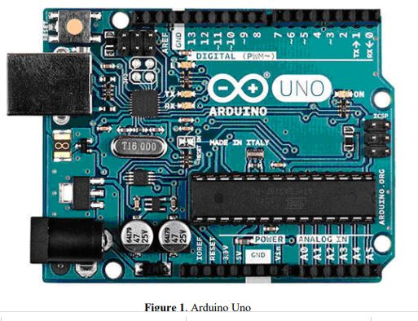

Slide 7
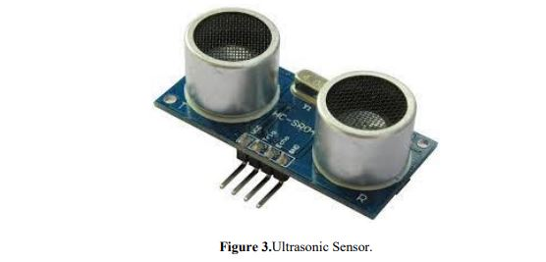

Slide 8
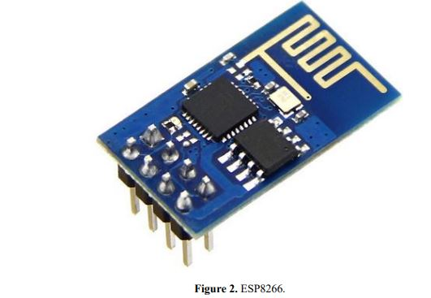

Slide 9
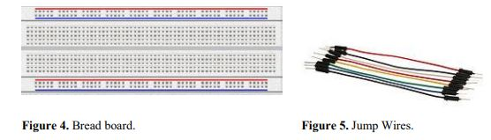

Slide 10
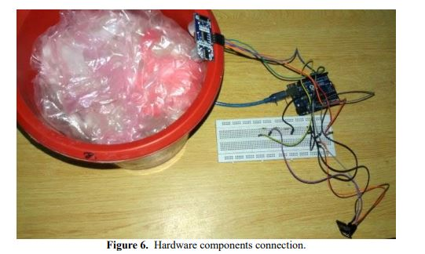

Slide 11
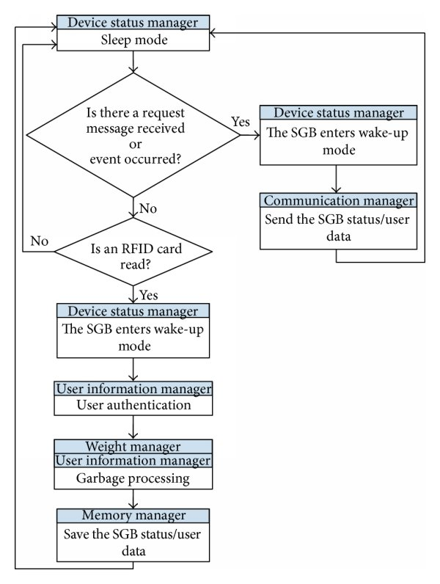
Flowchart:

Slide 12
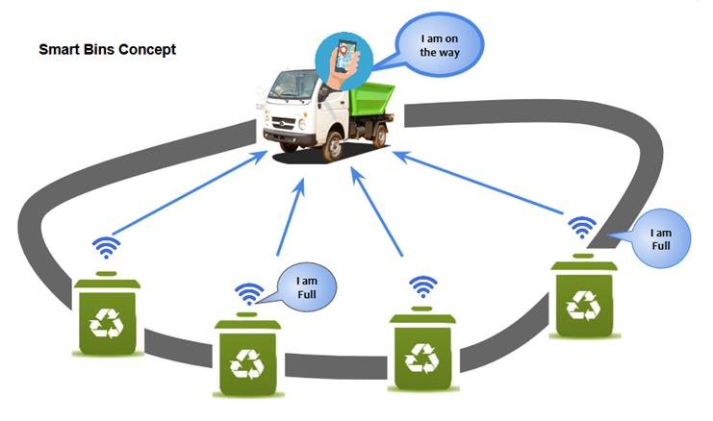
Large technology based waste management project idea:

Slide 13
Conclusion:
The main objective is to maintain the level of cleanliness in the city and form an environment which is better for living. By using this system we can constantly check the level of the garbage in the dustbins which are placed in various parts of the city. If a particular dustbin has reached the maximum level then the employees can be informed and they can immediately take certain actions to empty it as soon as possible. The employees can check the status of these bins anytime on their mobile phones. This can prove to be a very useful system if used properly. The system can be used as a benchmark by the people who are willing to take one step further for increasing the cleanliness in their respected areas. Ultrasonic sensor is being used in this system to check the level of garbage in the dustbins but in future various other types of sensors can be used with the ultrasonic sensor to get more precise output and to take this system to another level. Now this system can be used in certain areas but as soon as it proves its credibility it can be used in all the big areas. As this system also reduces manual work certain changes can be done in the system to take it to another level and make it more useful for the employees and people who are using it. In future, a team can be made which will be in charge for handling and maintaining this system and also to take care of its maintenances.

